Slide 1
Refactoring Superpowers: Make your C++ IDE do your work, faster and more safely
Clare Macrae – Italian C++, 19 June 2021

Slide 2
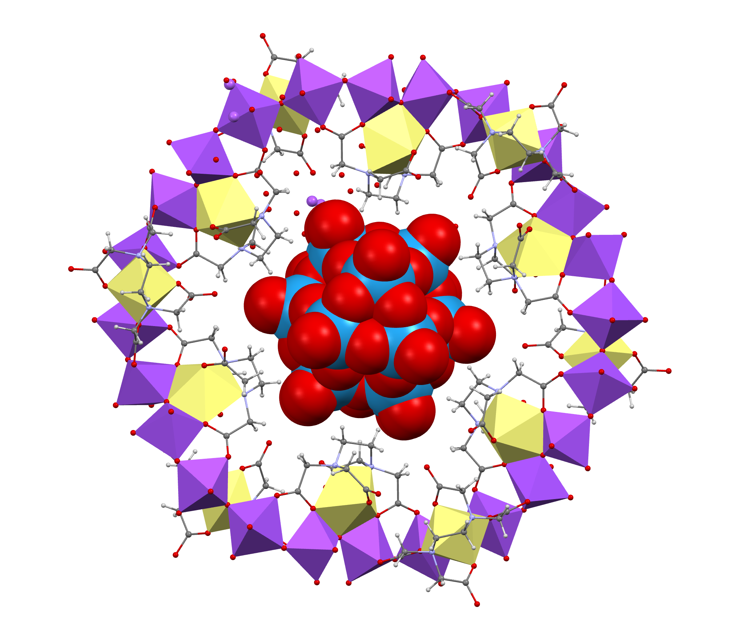
Clare Macrae
C++ >20 years
Chemistry
Approval Tests for C++
Legacy Code, Testing, Refactoring
Clare Macrae Consulting Ltd
clare@claremacrae.co.uk

Slide 3

Inspire
Explore
Experiment
Practice

Slide 4
Refactoring?

Slide 5
What is Refactoring?
✅ Restructuring Code
✅ Behaviour Same
❌ Fixing Bugs
❌ Adding Features

Slide 6
Micro-refactoring
Run Tests
Review Change
Commit
Revert
Fail
Pass

Slide 7
Safe, How?
IDE
Tests
Version control

Slide 8
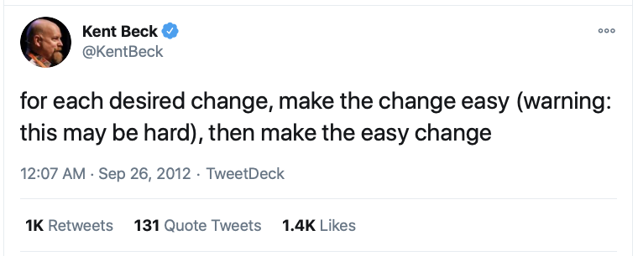
Notes:
https://twitter.com/kentbeck/status/250733358307500032?lang=en

Slide 9
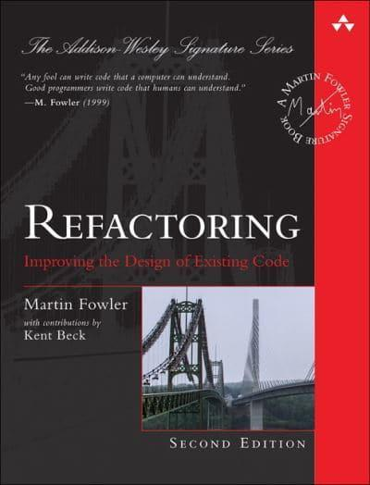
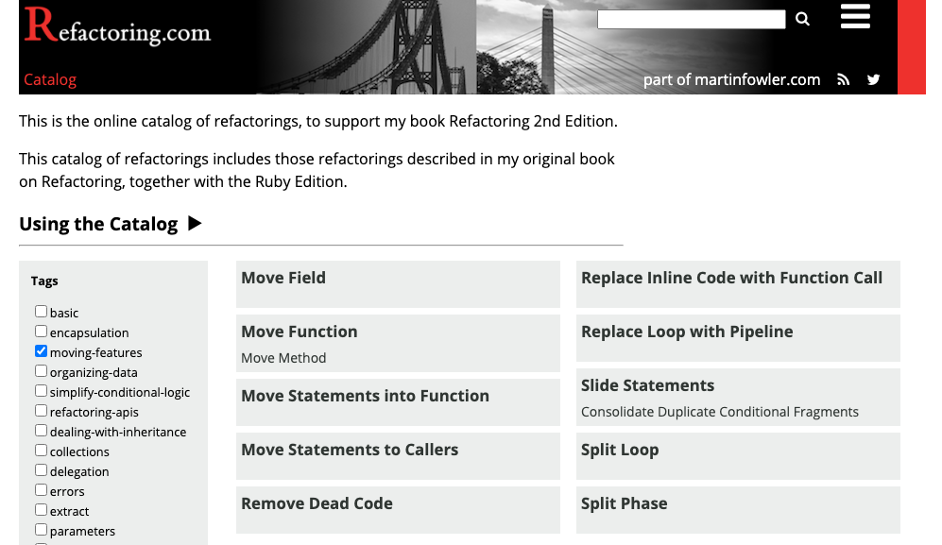

Notes:
https://martinfowler.com/books/refactoring.html

Slide 10

Sudoku

Slide 11
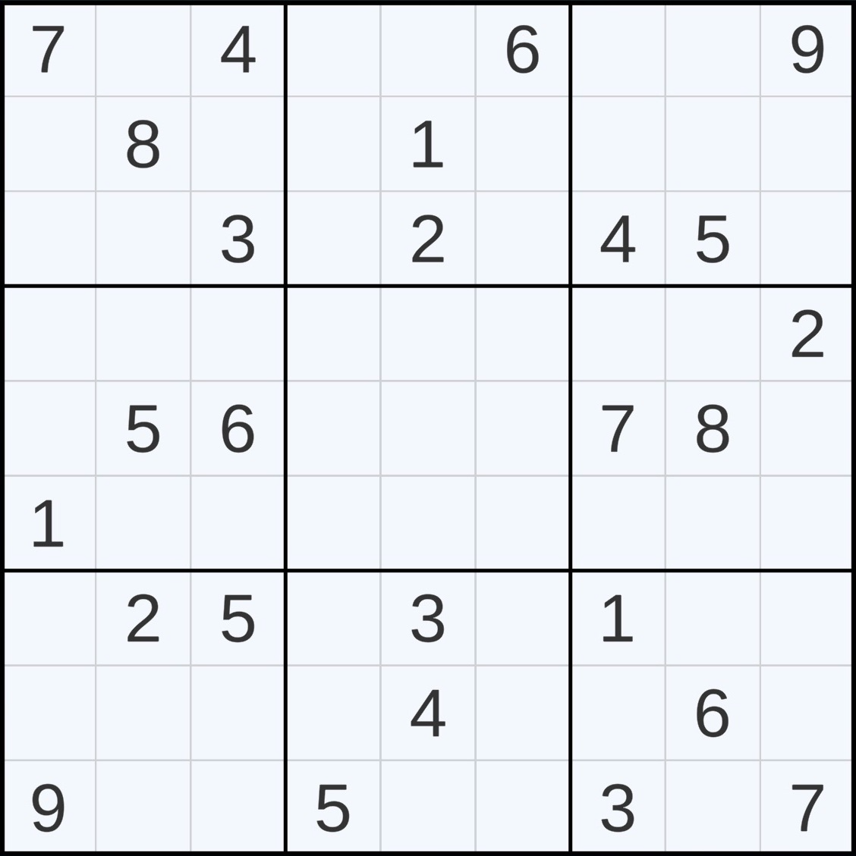
Sudoku Rules
Fill the gaps
Digits 1 to 9 once per…
3x3 Box
Row
Column

Slide 12
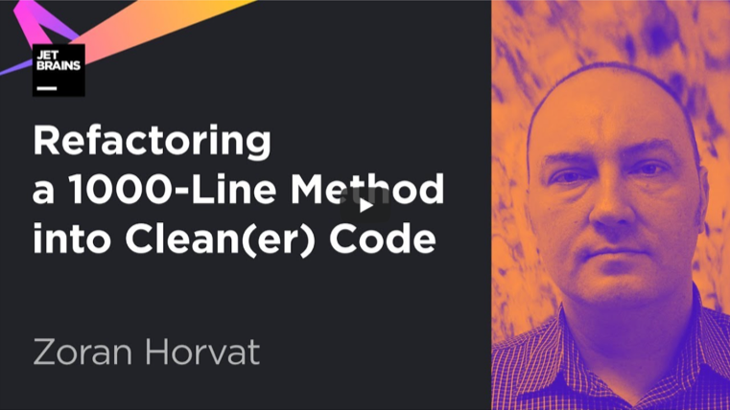
Notes:
https://www.youtube.com/watch?v=9S6qoFZiqCQ
Refactoring a 1000-Line Method into Clean(er) Code

Slide 13
Sudoku Kata
Coding practice demonstrating an awfully long method
In C#
Try to refactor this 1000-line long method
github.com/zoran-horvat/sudoku-kata
github.com/claremacrae/sudoku-kata

Slide 14

Previously…

Slide 15
“Leveraging the IDE to do more of the grunt work of refactoring is definitely something I will be experimenting more with”
“The C# tooling is much better than the C++ tooling in this regard”
“As a C++ programmer her mostly-C# talk did nothing for me”

Slide 16

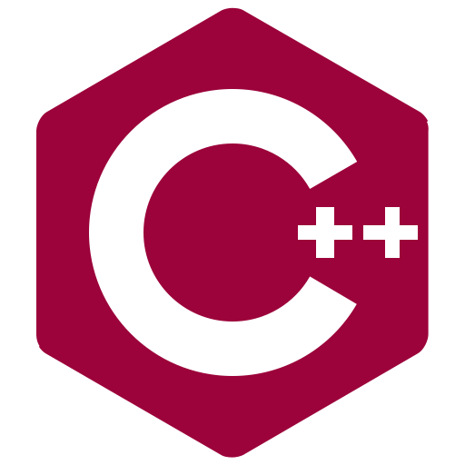
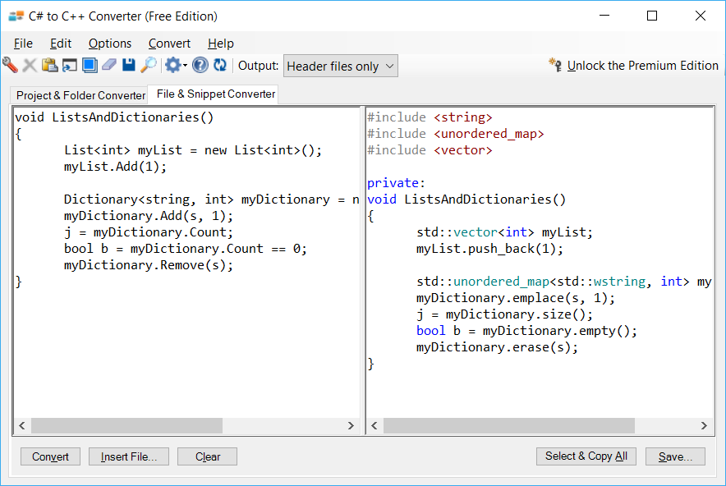
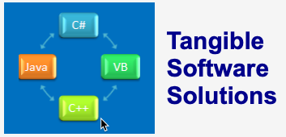
Manually…
Tangible Premium Edition
Tangible Free Edition
Much Manual Fixing

Slide 17
Sudoku Kata
Coding practice demonstrating an awfully long method
In C#
Try to refactor this 1000-line long method
github.com/zoran-horvat/sudoku-kata
github.com/claremacrae/sudoku-kata
In C++
Try to refactor this 1200-line long method
github.com/claremacrae/sudoku-kata-cpp

Slide 18
Step 1
Add Tests

Slide 22
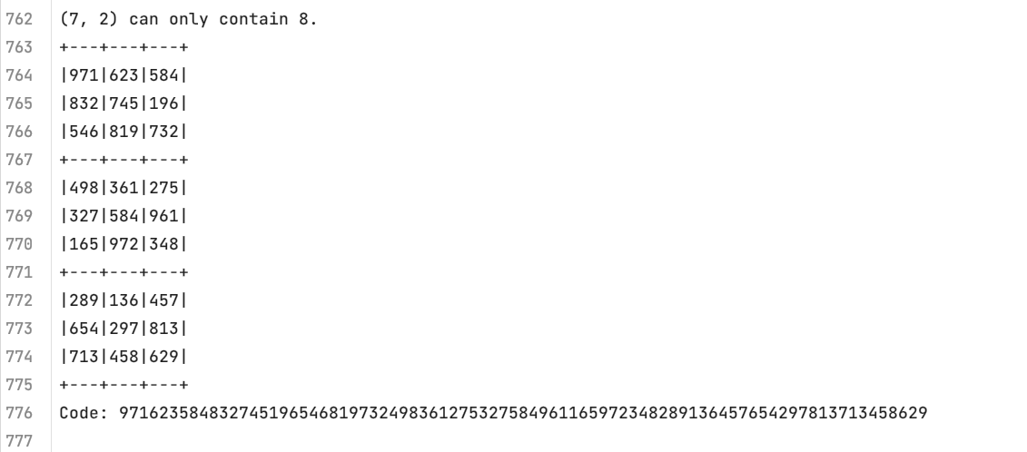

Slide 23

Refactoring: Extract Parameter

Slide 24
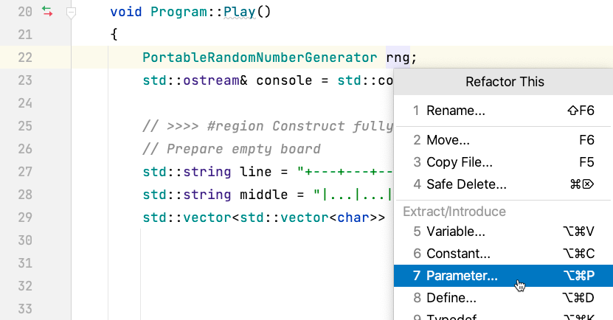
Extract Parameter: Step 1…

Slide 25
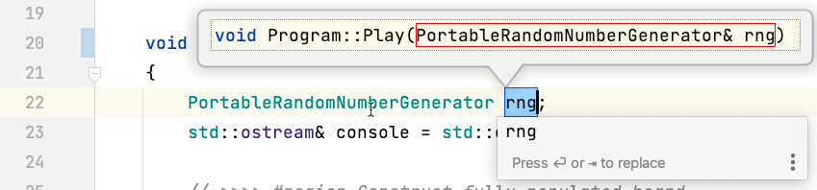
Extract Parameter: Step 2…

Slide 26
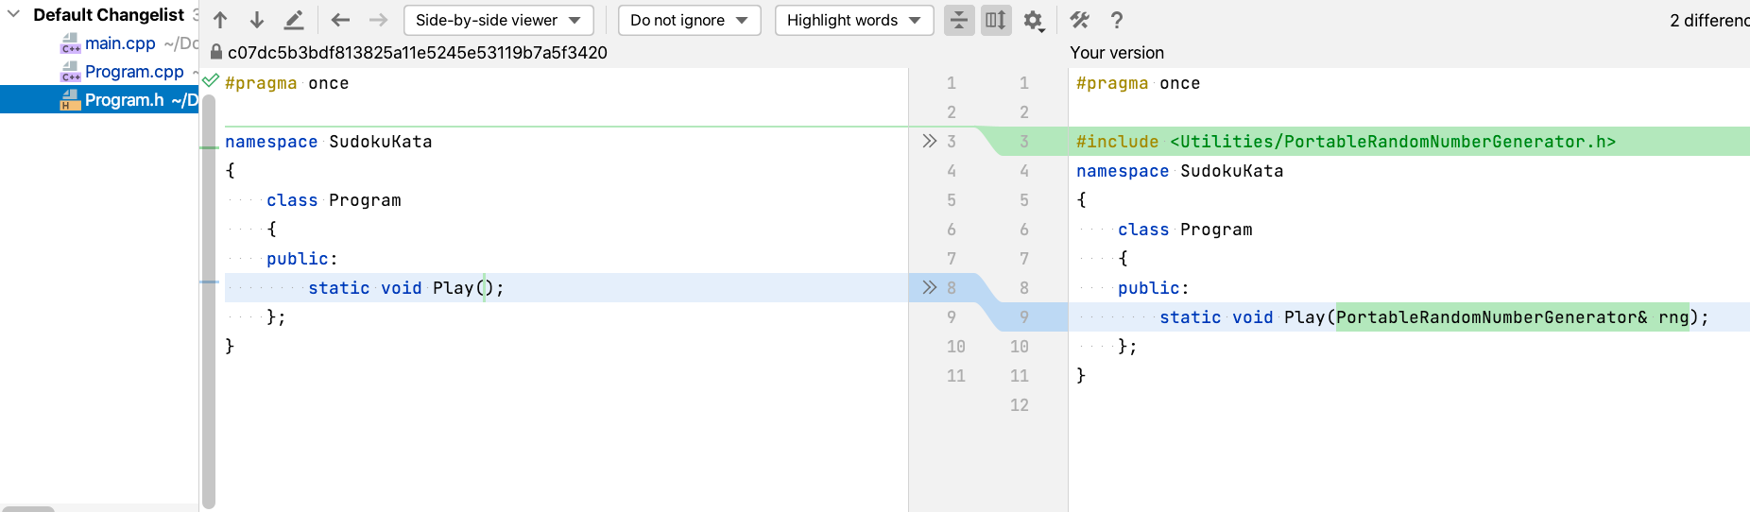
Extract Parameter: Step 3…

Slide 27
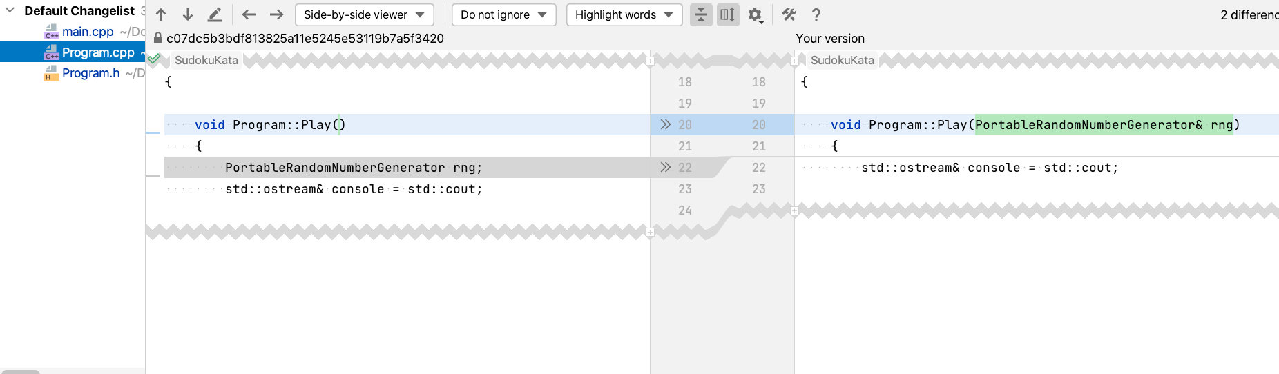
Extract Parameter: Step 4…

Slide 28
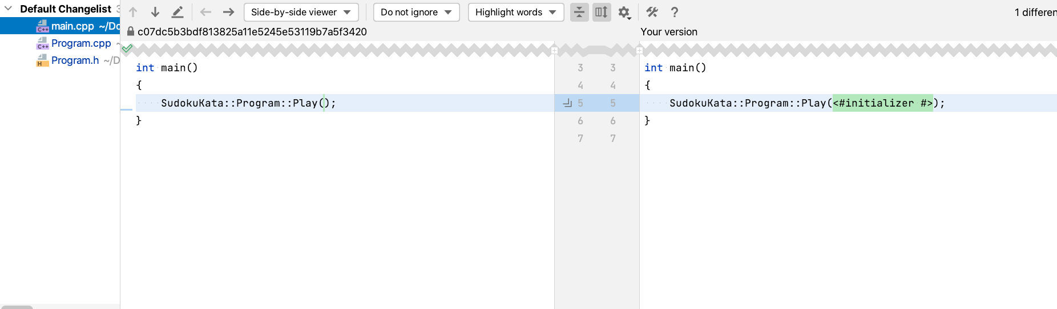
Extract Parameter: Step 5…
Notes:
ReSharper C++ and Visual Assist don’t have Extract Parameter

Slide 29
Tests now Stable
// Before adding tests class Program { public: static void Play(); };
// After class Program { public: static void Play( std::ostream& console, PortableRandomNumberGenerator& rng ); };

Slide 30
Adding Approval Tests
TEST_CASE( "Should do the same thing twice" ) { std::stringstream console; for ( int seed = 0; seed < 10; seed++ ) { console << ">>>>>>>>>>>>>>>>>>>>> Output with seed: " << seed << '\n'; PortableRandomNumberGenerator random( seed ); Program::Play( console, random ); } Approvals::verify( console.str() ); }

Slide 31
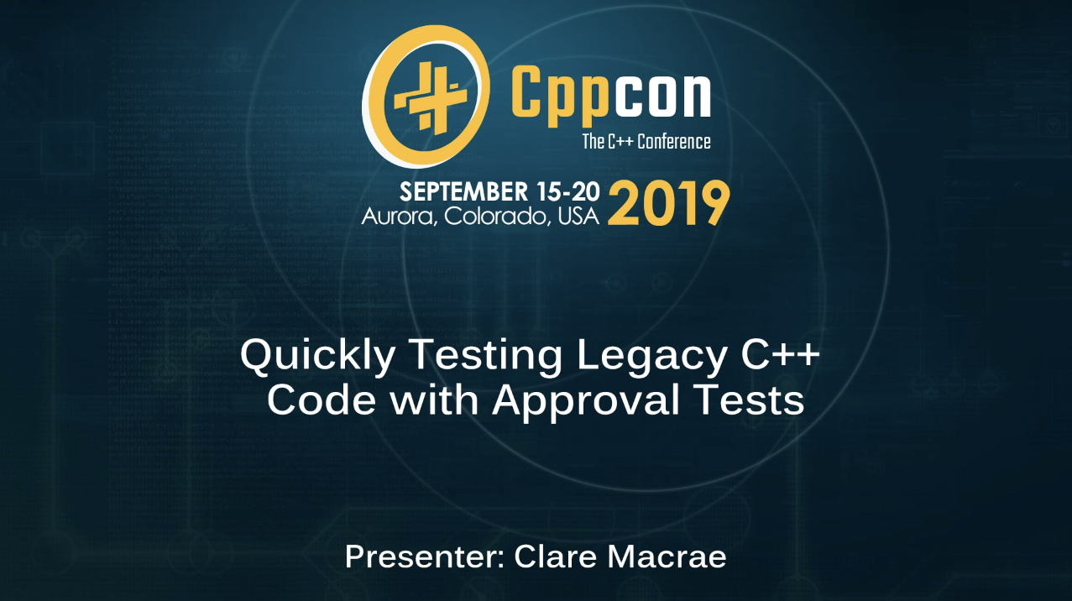

Slide 32


Slide 33
Avoid the Refactoring Bottomless Pit
Know the Purpose
Particular Bug?
Particular Feature?

Slide 34
Today’s Goal
Solve puzzles set by others

Slide 35

Warning: Don’t be tempted to read the code!

Slide 36
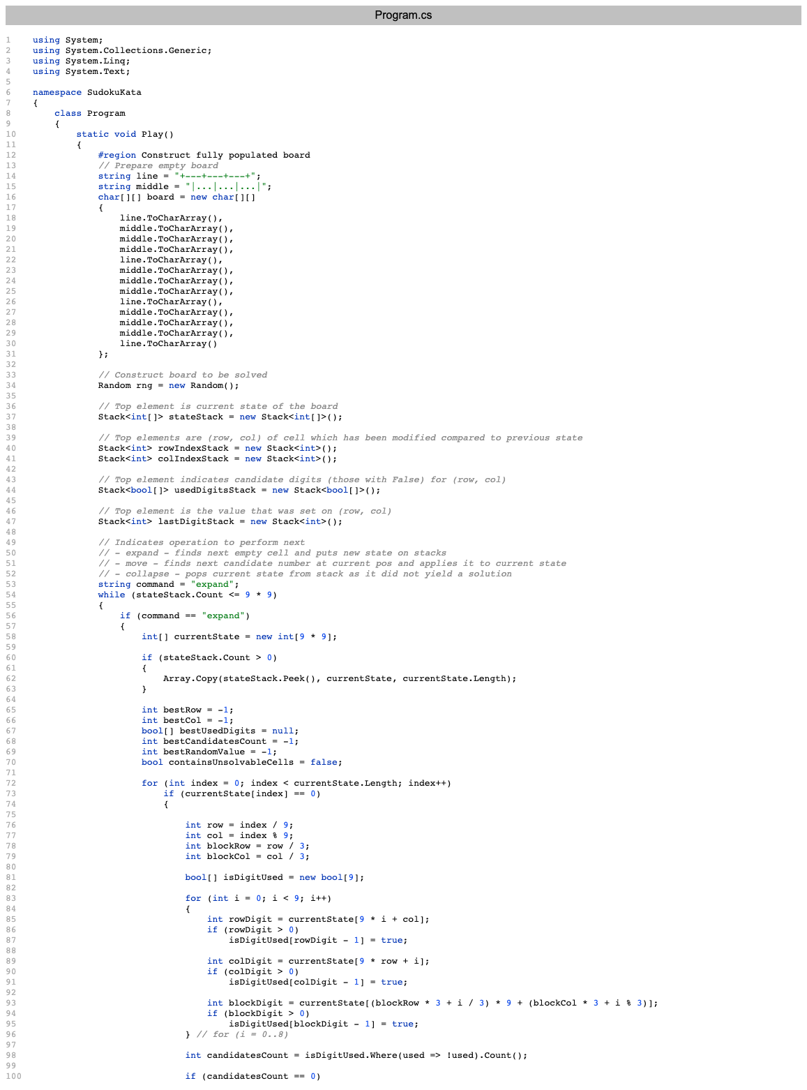
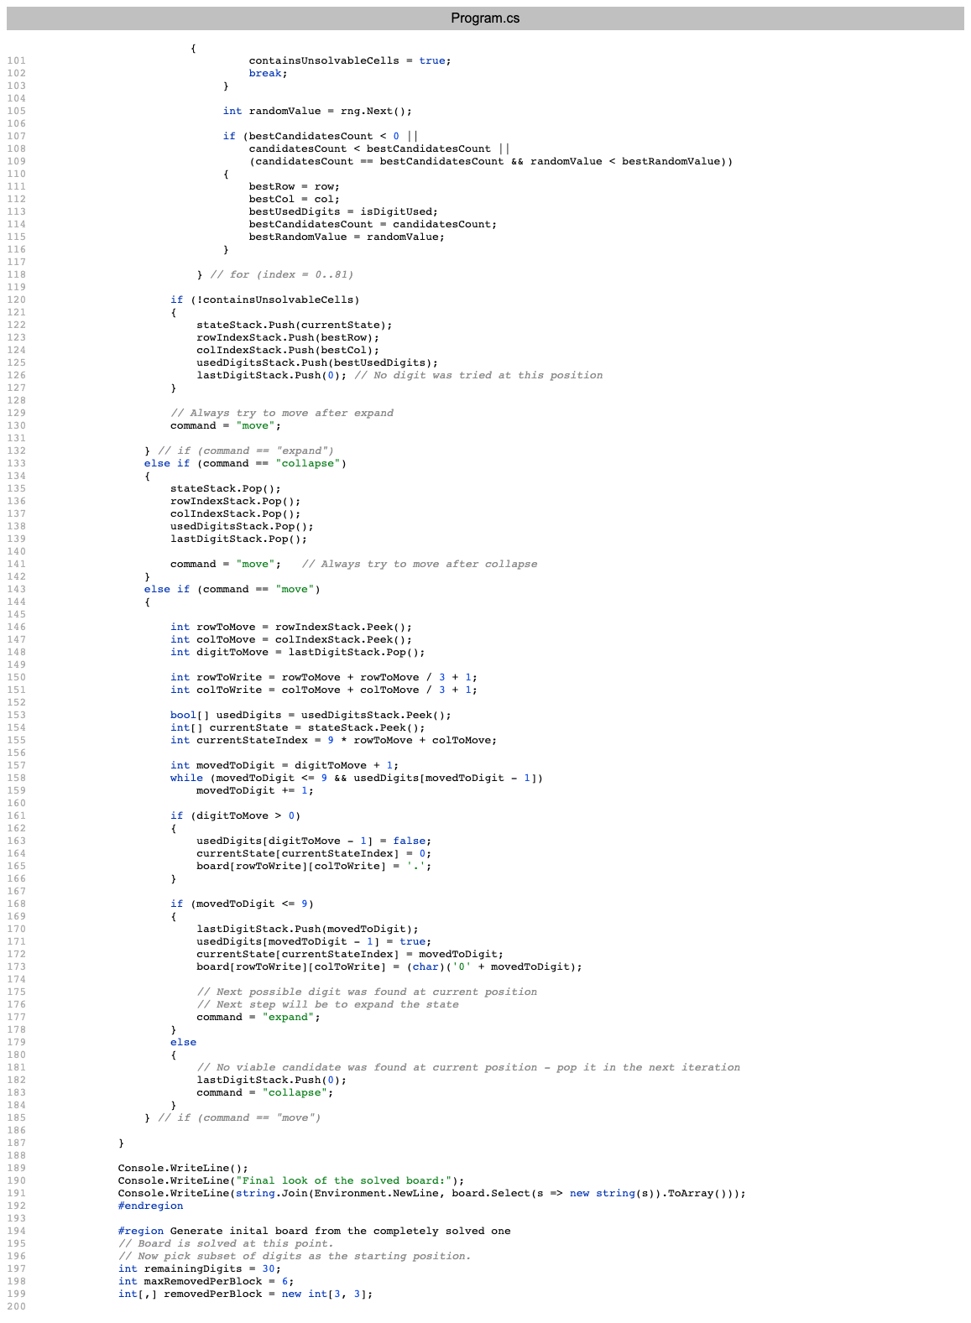
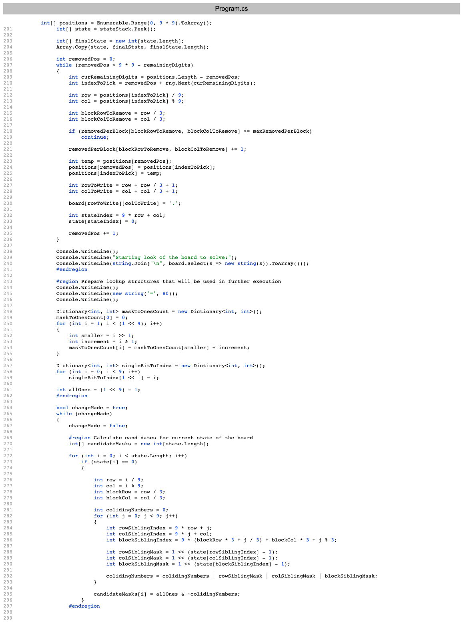
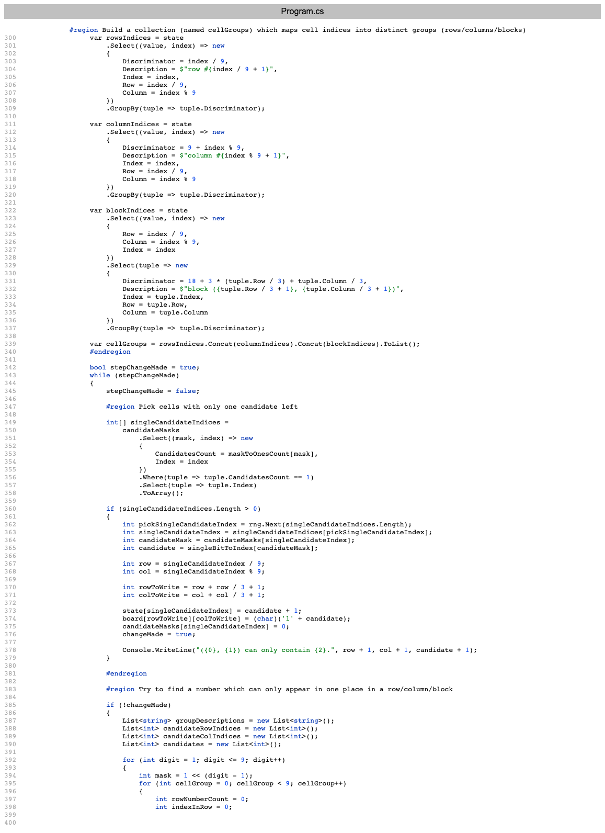
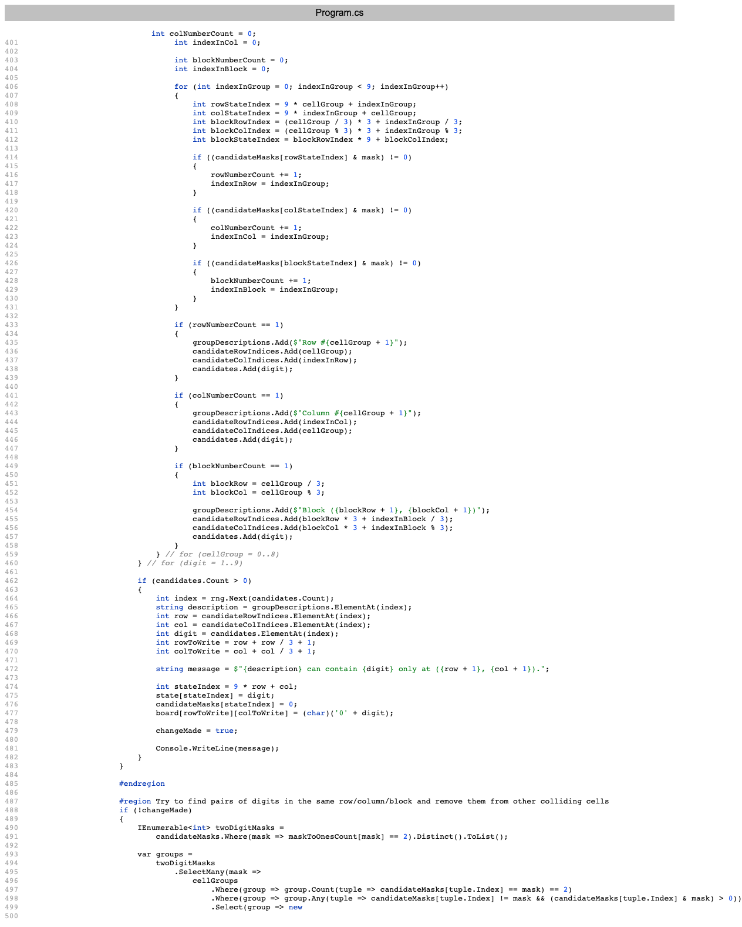
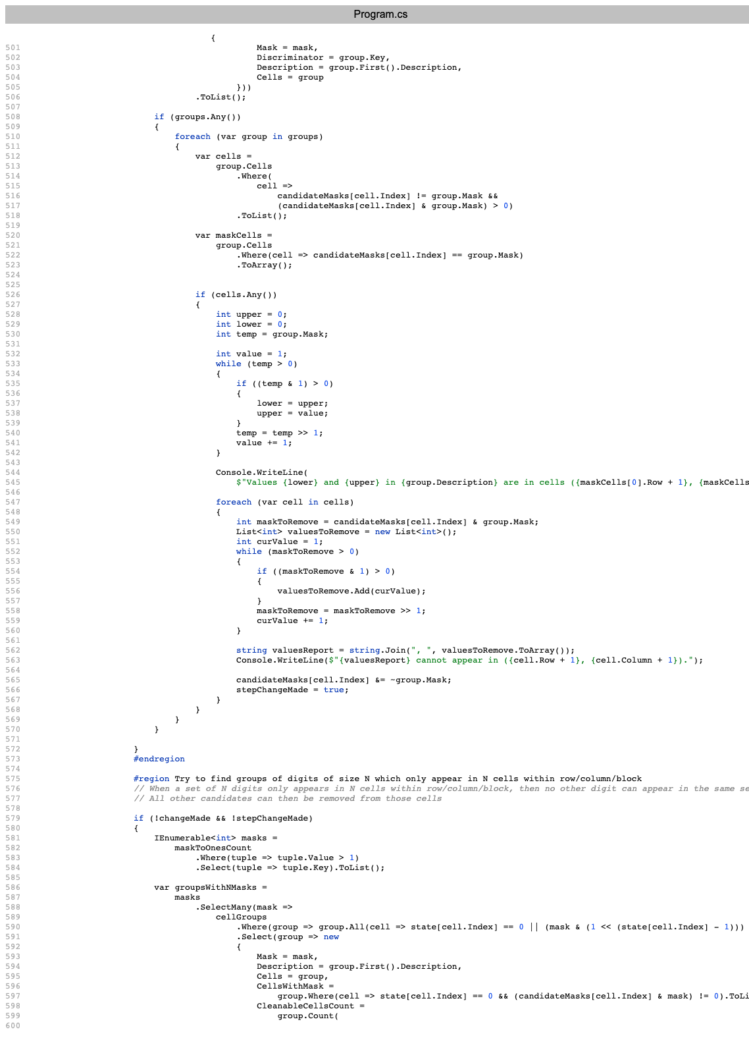
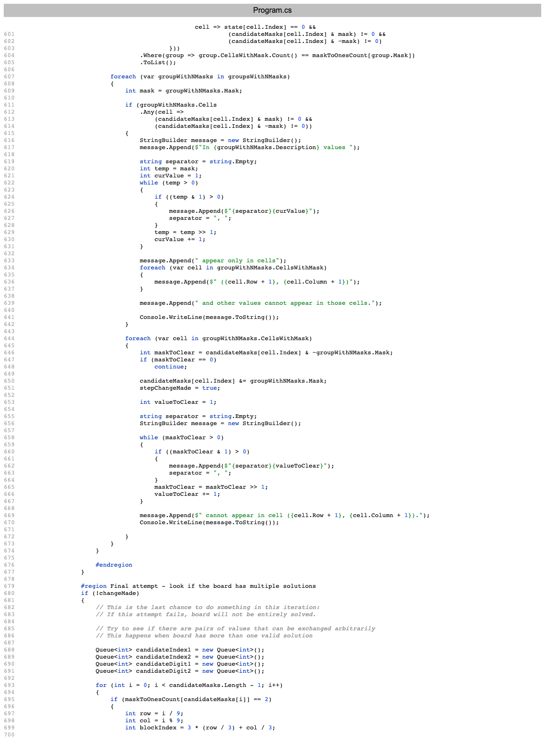
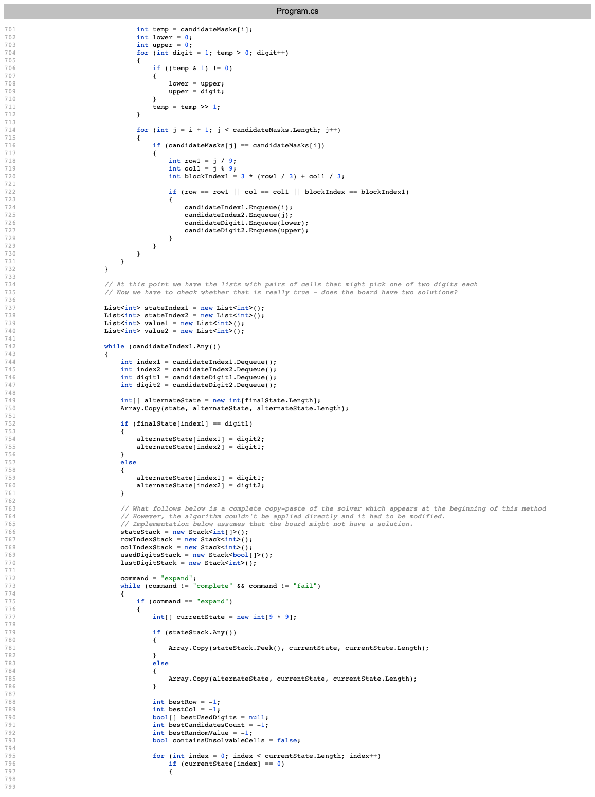
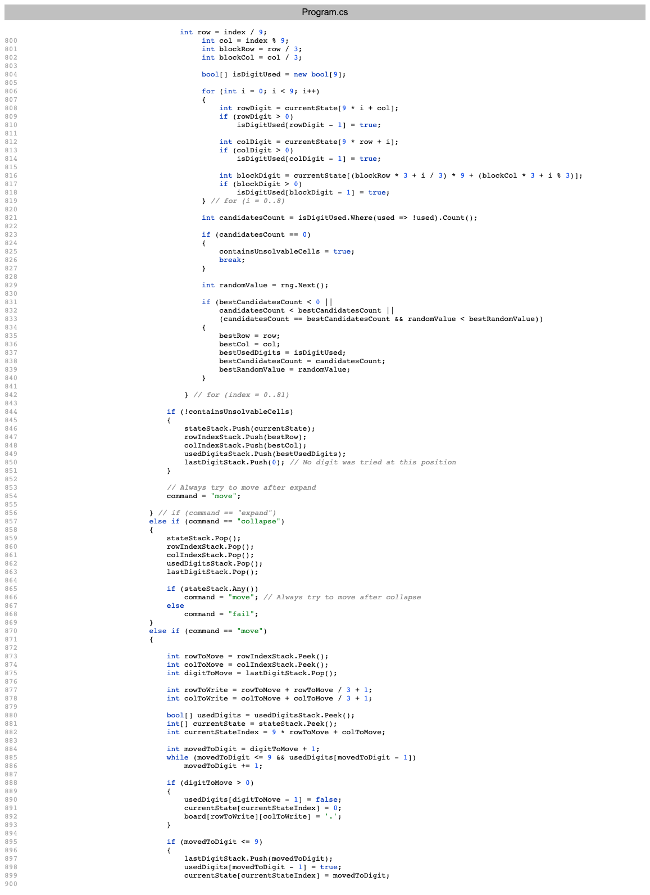
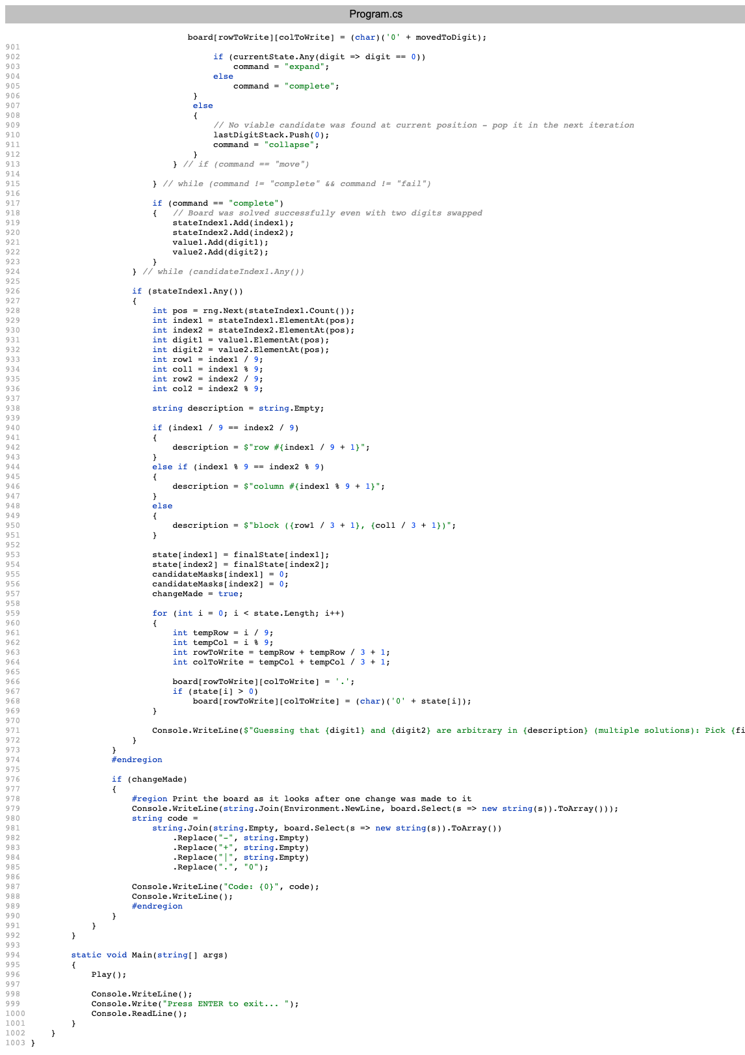
1,004 lines
1,204 lines

Slide 37
What to do with long code?
Extract Method

Slide 38
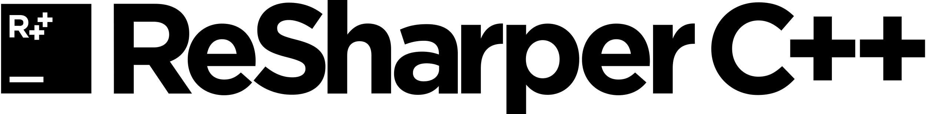
Refactoring: Extract Method Version 1

Slide 39
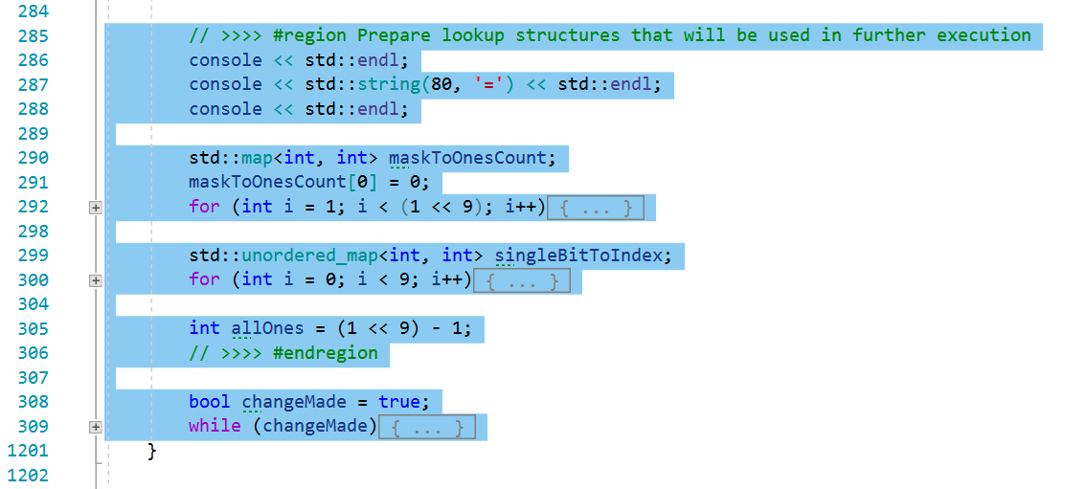
Extract Method v1: Step 1

Slide 40
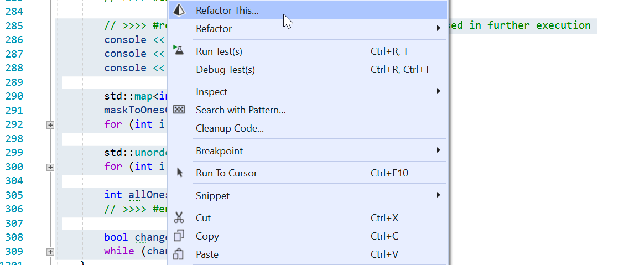
Extract Method v1: Step 2

Slide 41
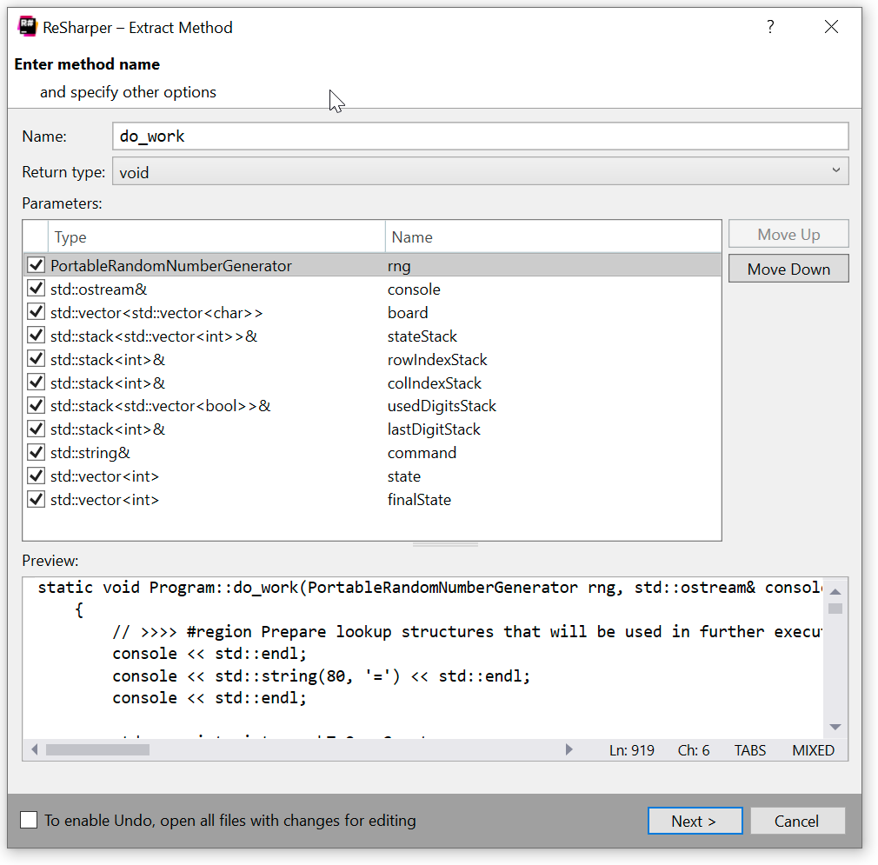
Extract Method v1: Step 3

Slide 42
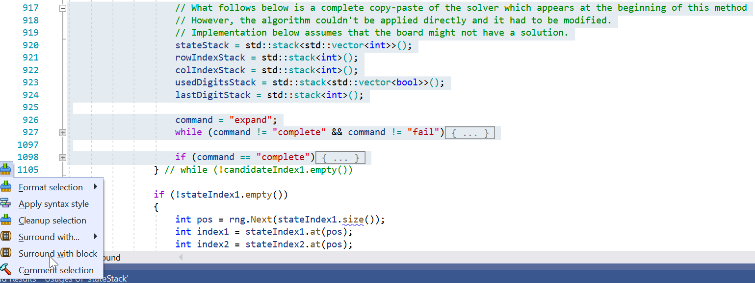
Surround with { }

Slide 43
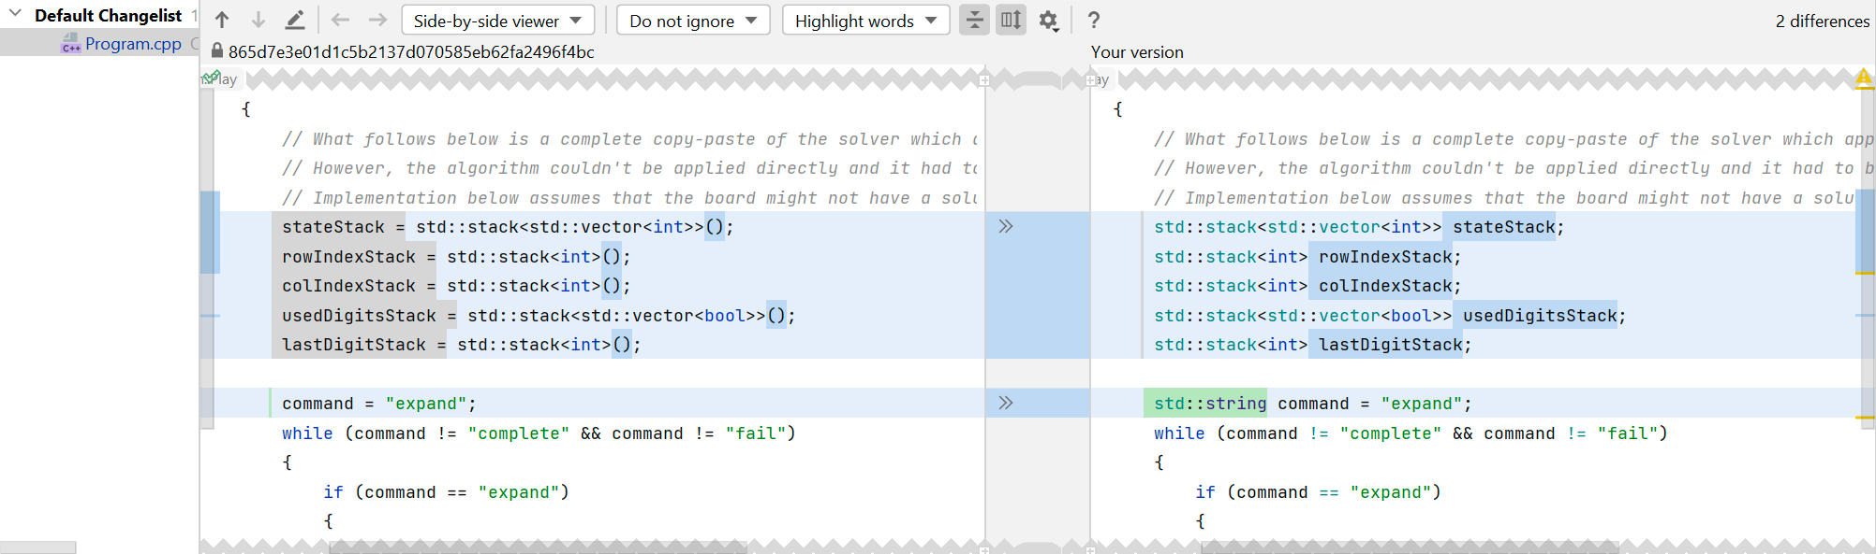
Independent copy of data

Slide 44


Refactoring: Extract Method Version 2
Visual Assist

Slide 45
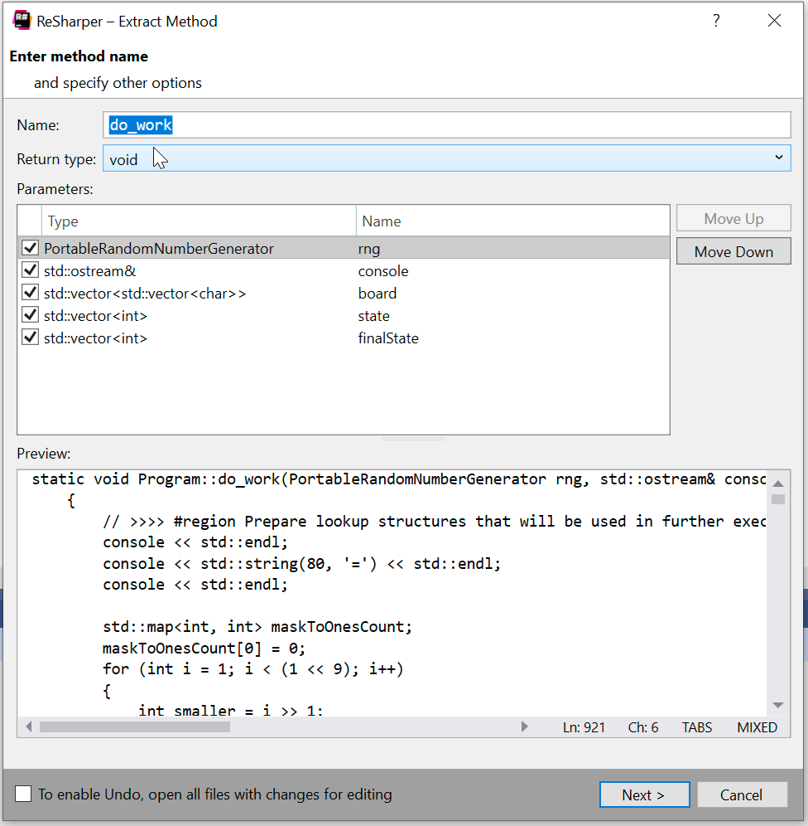
Extract Method v2: ReSharper C++

Slide 46
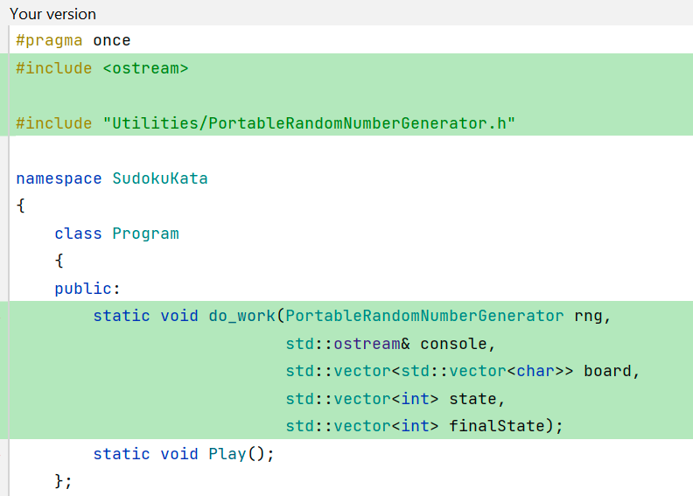
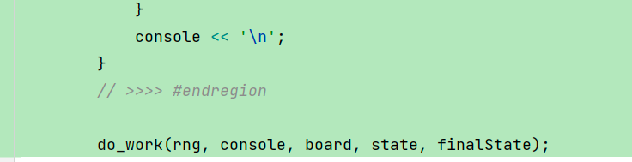
Extract Method v2: ReSharper C++
Program.h
Program.cpp
✅
✅

Slide 47
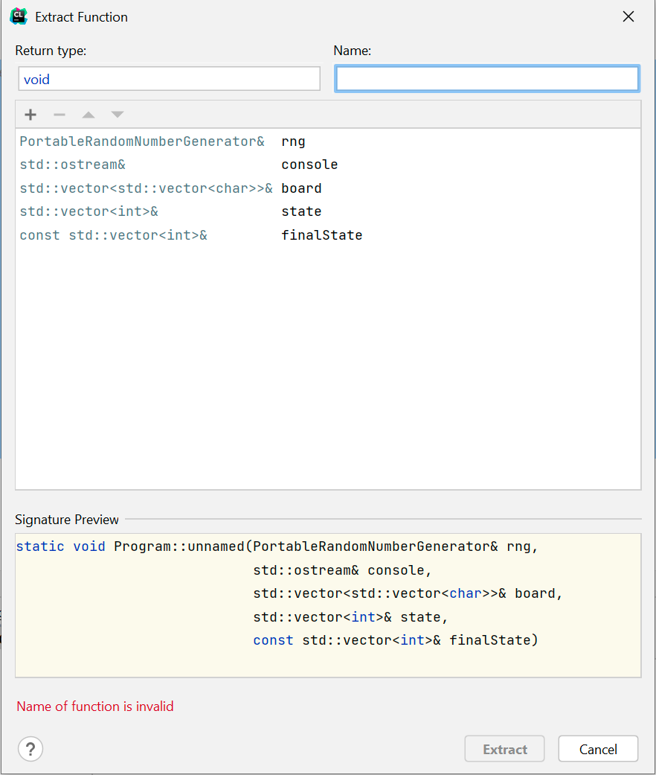
Extract Method v2: CLion

Slide 48
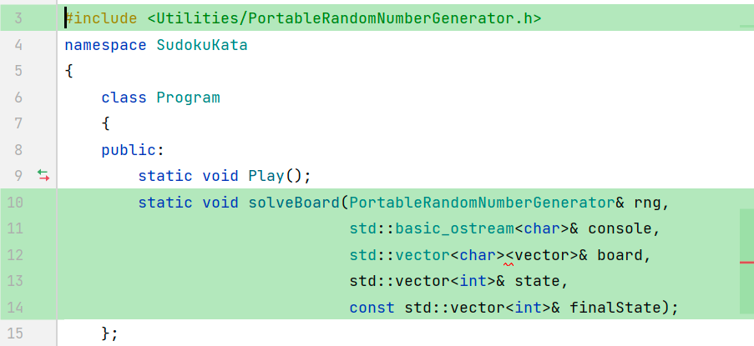
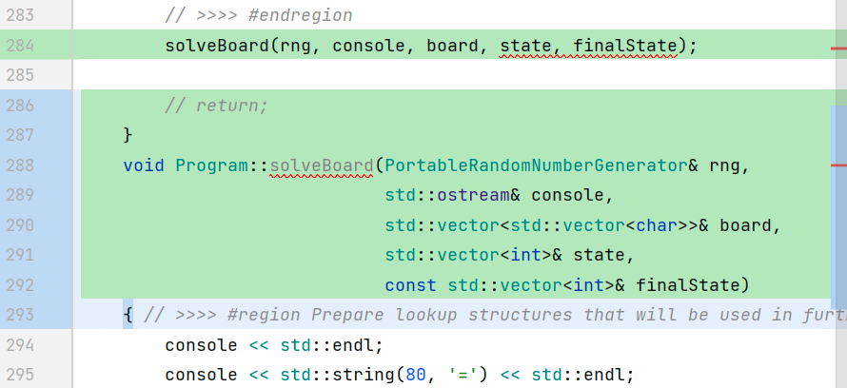
Extract Method v2: CLion
Program.h
Program.cpp
✅
❌

Slide 49
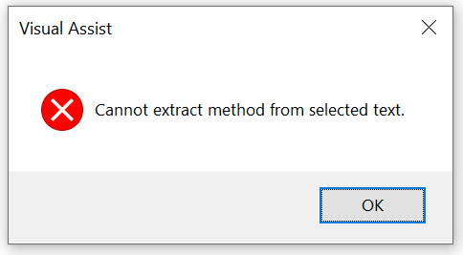
Extract Method v2: Visual Assist
❌
Visual Assist

Slide 51
Refactoring: Extract Method Version 3
Manually & safely

Slide 52
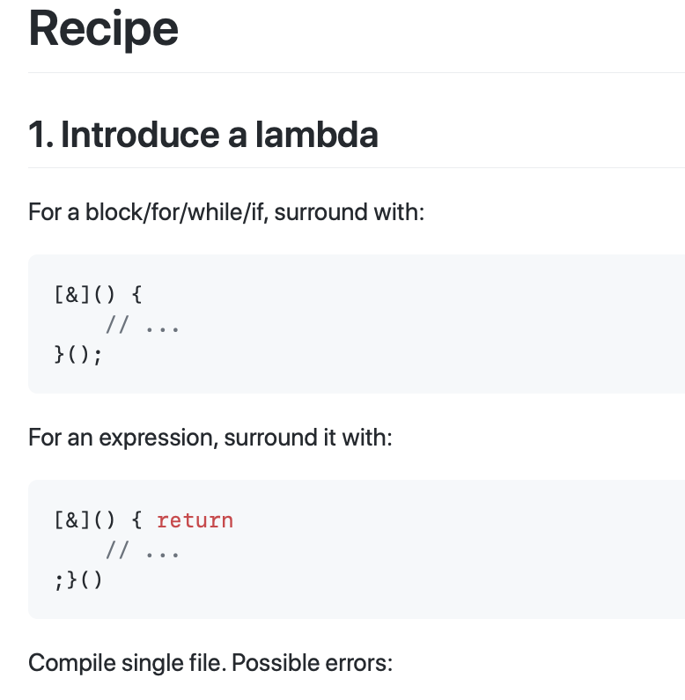
Awareness: “Provable Refactorings”
github.com/digdeeproots/provable-refactorings/
A collection of refactoring recipes that are provably safe. They never accidentally introduce nor fix a bug, including one that you don't know exists. They maintain all behavior, including unknown or unspecified behavior. To accomplish this, each recipe is concrete and language-specific.
recipes/core-6/extract-function/cpp.md
9 steps
final step is optional

Slide 53
Per-refactor checklist
references?
public/protected/private?
const?
order of methods/fields?
[[nodiscard]]?
clutter?
extra variables?
std::__1::make_unique

Slide 54
Extract Grid Class
#pragma once #include <vector> class Grid { public: std::vector<std::vector<char>> board; std::vector<int> state; std::vector<int> finalState; };
Notes:
Moving towards a better place

Slide 55
On-demand String Writing
std::string GridStringifier::ConvertToString( const std::vector<int>& board ) { const std::string divider = "+---+---+---+\n"; auto result = divider; result += ToRowNumbered( board, 0 ); result += ToRowNumbered( board, 1 ); result += ToRowNumbered( board, 2 ); result += divider; result += ToRowNumbered( board, 3 ); result += ToRowNumbered( board, 4 ); result += ToRowNumbered( board, 5 ); result += divider; result += ToRowNumbered( board, 6 ); result += ToRowNumbered( board, 7 ); result += ToRowNumbered( board, 8 ); result += divider; return result; }

Slide 56
Grid Behaviour
#pragma once #include <string> #include <vector> class Grid { public: std::string ToCode() const; std::string ToString() const; public: std::vector<int> state; std::vector<int> finalState; };
Notes:
Moving towards a better place

Slide 57
Notes:
https://twitter.com/kentbeck/status/250733358307500032?lang=en

Slide 58
Solving a Grid
TEST_CASE( "Should solve a grid" ) { // See Easy https://www.websudoku.com/?level=1&set_id=2417252423 auto input = "004509000500100048090020560000030016340010025720060000059040070270001003000702600"; auto expected = "164589237532176948897423561985234716346917825721865394659348172278691453413752689"; CHECK( expected == Grid::Solve( input ).ToCode() ); }
Notes:
This is expressive – intent is clear

Slide 59
New Feature
Grid::Grid( const std::string& code ) { assert( code.size() == 81 ); for ( char digitCharacter : code ) { state.push_back( digitCharacter - '0' ); } finalState = std::vector<int>( 81, 0 ); }
Grid Grid::Solve( const std::string& code ) { std::stringstream s; PortableRandomNumberGenerator random; Grid inputGrid( code ); Program::solvePuzzle( s, random, inputGrid ); return inputGrid; }
Notes:
This is our feature!
Talk about the ROI of this, versus hacking in the feature…
Pays back very quickly, next time I use this code

Slide 60
Adding Abstraction

Slide 61
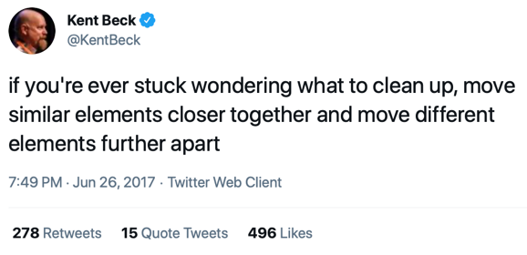
Notes:
https://twitter.com/kentbeck/status/250733358307500032?lang=en

Slide 62
Finding the Concepts
Class with lots of methods
Move related things closer together
Move un-related things further apart

Slide 63
Representing the Concepts
Smell: Primitive Obsession
Refactorings:
Extract Field
Encapsulate Field
Extract Class

Slide 64
Tips
Really matters whether static or not
Can move methods to
different classes
classes that don’t yet exist
Can take static methods and make them non-static
Notes:
https://twitter.com/KentBeck/status/879411232725389312

Slide 65
IDE Coding Help

Slide 66
Finding Refactoring in IDE
Cursor location matters!
Many ways to access Refactoring
“Refactoring” in Main Menu
Right-click and “Refactoring”
“Refactor This”
Quick Fix
Generate Code

Slide 67
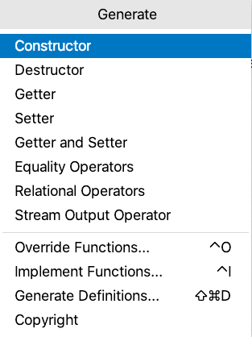
Generate Common Patterns

Slide 68
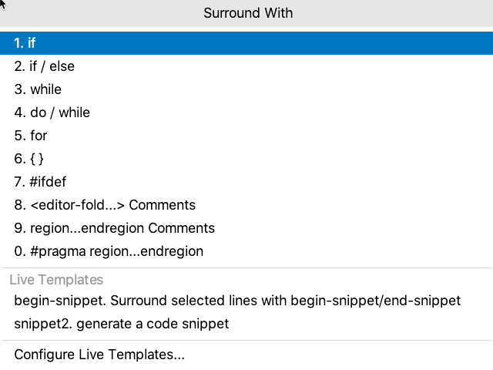
Surround Selection With

Slide 69
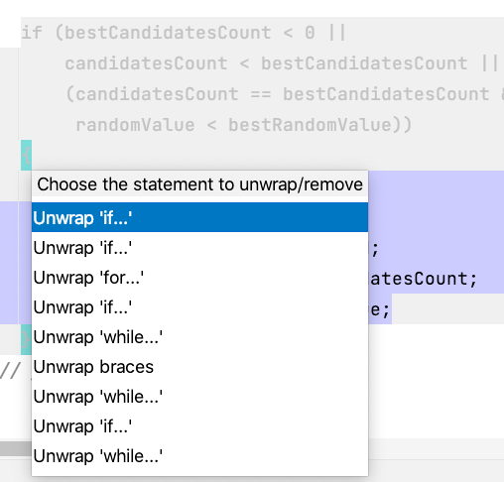
Unwrap/Remove

Slide 70
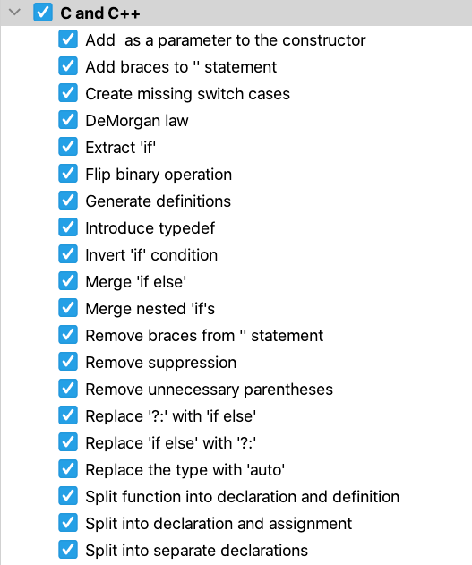
Intentions

Slide 71
Your IDE
Language Differ
Development Tools Differ
Experiment!

Slide 72
Conclusions

Slide 73
Benefits of Refactoring
You'll be less tired at the end
Confident that the behaviour is unchanged
Users get the feature sooner

Slide 74
Safe, How?
IDE
Tests
Version control

Slide 75
My Message To You!
Explore your IDE’s Auto-Fixes and Refactoring Features
Report bugs
Upvote bugs
Request features!
Practice refactoring difficult code
Know how to use Safe Steps to transform the code

Slide 76
Thank You!
@ClareMacraeUK
clare@claremacrae.co.uk
claremacrae.co.uk
bit.ly/refactoring-superpowers

